Slide 1
Ch. 20 Learning Targets
I can:
calculate and explain the quantity of a resource to be hired by a firm
construct a short run demand schedule for a resource
explain the concept of derived demand
explain the relationship between VMP and the demand for an input

Slide 2

What influences how much a person earns?
Derived Demand: demand from the firm’s output price (How much people want to buy the stuff made/service provided)

Slide 3


Circular Flow of a Market Economy
Factor Market
Households sell. Firms buy.
Land, Labor, & Capital
Finished Products
Product Market
Firms sell. Households buy.

Slide 4




Factors of Production: any resource that is used by firms to produce goods and services, are productive & earn income repeatedly
Resources provided by nature that are used to make goods and services (water, trees, oil, coal, etc.)
Physical Capital: manufactured resources (buildings, tools, machines, etc.)
Human Capital: improvement in labor created by education & knowledge that is embodied in the workforce.
Entrepreneurs
The effort that people devote to a task for which they are paid

Slide 5
Circular Flow of a Market Economy
Factor Market
Households sell. Firms buy.
Land, Labor, & Capital
Finished Products
Product Market
Firms sell. Households buy.

Slide 6



What is a factor, anyway?
Imagine a business that produces shirts. The business will make use of workers and machines—that is, of labor and capital. But it will also use other inputs, such as electricity and cloth. Are all of these inputs factors of production?
No: Labor and capital are factors of production, but cloth and electricity are not.

Slide 7
Factors of Production
Factors are productive and earn income repeatedly (labor, physical capital, human capital, land, entrepreneurship)
Inputs are used up in the production process

Slide 8
Marginal Productivity (MPL) and Factor Demand
The economic concepts are similar to those for product markets
The demand for a factor of production is derived from the demand for the good or service produced from this resource

Slide 9
Marginal Productivity (MPL) and Factor Demand
All economic decisions are about comparing costs and benefits. For a producer, it could be deciding whether to hire an additional worker.
But what is the marginal benefit of that worker?
We will use the production function, which relates inputs to output to answer that question.
Assume throughout that all producers are price-takers—they operate in a perfectly competitive industry.

Slide 10
Labor as a Factor of Production
Total product (TP) = the amount of output that can be produced as one input changes
Want to answer: How many inputs (instructors) are enough?
Lester's Driving School
# instructors | # driving lessons (TP)
0 | 0
1 | 8
2 | 15
3 | 21
4 | 26
5 | 30
6 | 33

Slide 11
Labor as a Factor of Production
Marginal product of labor (MPL) = additional output per input
Lester's Driving School
# instructors | # driving lessons (TP) | MPL
0 | 0
1 | 8 | 8
2 | 15 | 7
3 | 21 | 6
4 | 26 | 5
5 | 30 | 4
6 | 33 | 3

Slide 12
Labor as a Factor of Production
Value of the marginal product of labor (VMPL) = the value of the additional output per input
Each lesson sells for $35
  VMPL= MPL x $35
Lester's Driving School
# instructors | TP | MPL | VMPL
0 | 0
1 | 8 | 8 | $280
2 | 15 | 7 | 245
3 | 21 | 6 | 210
4 | 26 | 5 | 175
5 | 30 | 4 | 140
6 | 33 | 3 | 105

Slide 13
How many workers should they employ to maximize profit?
A price-taking firm’s profit is maximized by producing the quantity of output at which the marginal cost of the last unit produced is equal to the market price.
First determine the optimal quantity of output, then go back to the production function and find the optimal number of workers.
There is also an alternative approach based on the value of the marginal product…

Slide 14
Value of the Marginal Product
The value of the marginal product of a factor is the extra value of output generated by employing one more unit of that factor. Looks like a demand curve due to diminishing marginal return.
Value of the marginal product of labor =
VMPL = P × MPL
The general rule is that a profit-maximizing, price-taking producer employs each factor of production up to the point at which the value of the marginal product of the last unit of the factor employed is equal to that factor’s price.

Slide 15
Labor as a Factor of Production
If each driving instructor gets paid $160, how many instructors should be hired?
Optimal :
VMPL= W
Lester's Driving School
# instructors | TP | MPL | VMPL
0 | 0
1 | 8 | 8 | $280
2 | 15 | 7 | 245
3 | 21 | 6 | 210
4 | 26 | 5 | 175
5 | 30 | 4 | 140
6 | 33 | 3 | 105

Slide 16
Value of the Marginal Product
To maximize profit, George and Martha will employ workers up to the point at which, for the last worker employed, VMPL = W.

Slide 17
The Demand for a resource: Perfect Competition in the sale of the Product
Units of resource
Total
Product
Product
Price
Total
Revenue
MPL
VMPL
0
1
2
3
4
5
6
7
0
7
13
18
22
25
27
28
--
7
__
__
__
__
__
__
2
2
2
2
2
2
2
2
0
14
__
36
__
50
__
56
--
14
__
10
8
__
4
2

Slide 18
The Demand for a resource: Imperfect Competition in the sale of the product
Units of resource
Total
Product
Product
Price
Total
Revenue
MPL
VMPL
0
1
2
3
4
5
6
7
0
7
13
18
22
25
27
28
--
7
6
5
4
3
2
1
2.80
2.60
2.40
2.20
2.00
1.85
1.75
1.65
0
18.20
31.20
39.60
44.00
46.25
47.25
46.20
----
18.20
13.00
8.40
4.40
2.25
1.00
-1.05

Slide 19
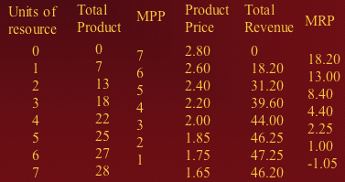
What is the evidence that this is an imperfectly competitive product market?
Why does the MRP of the imperfectly competitive firm fall more rapidly than the MRP of the perfect competitor?
A: Demand curve will be steeper than in PC. The steeper slope results from both an decrease in the MPP and a decrease in the product price required to permit the firm to sell a larger output.

Slide 20
Economic Rent
an ”extra" payment for a factor of production (such as land) that does not change the amount of the factor that is supplied.

Slide 21
Application of Rent Theory: Salaries of Professional Athletes
When athletes would be willing to play for quite a bit less than their salary, the “excess” salary is economic rent.
  This same analysis applies to any factor of production whose supply curve is not horizontal.
  Only those factors that can be reproduced by a number of producers at constant cost earn no rents.

Slide 22

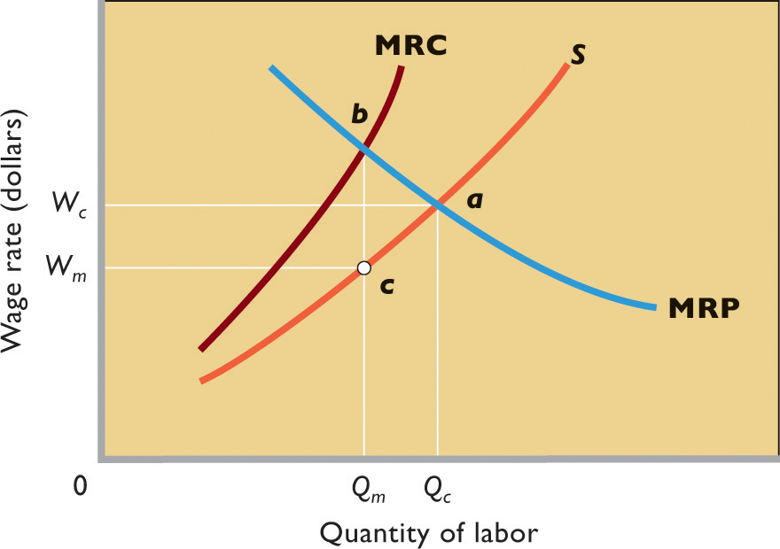
Monopsony
a market structure in which there is only a single buyer of a good, service, or resource.

Slide 23
Equilibrium Wage and Employment
The MRC curve lies above labor supply curve and the MRC exceeds the wage rate
The monopsonist will hire a quantity of labor where the MRC equals the MRP.
Using the labor supply curve, the monopsonist will pay a wage rate based on this quantity of labor.

Slide 24
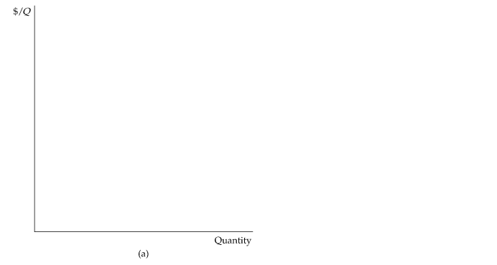
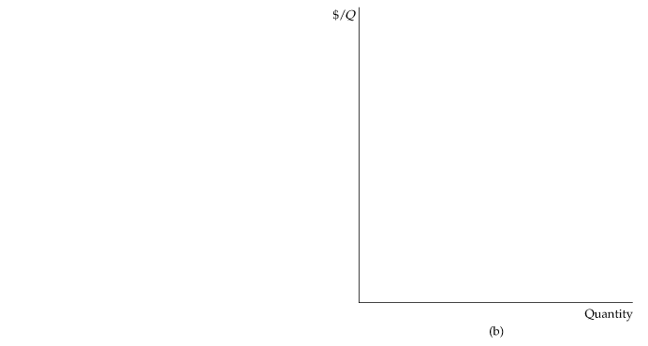
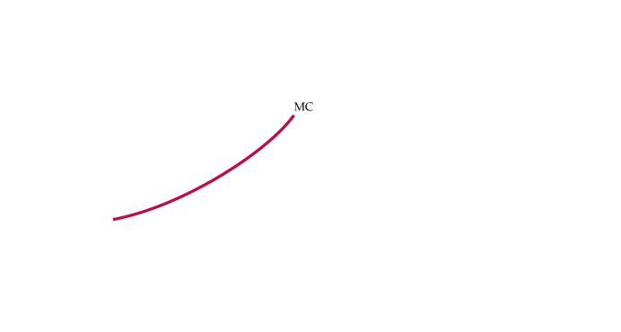
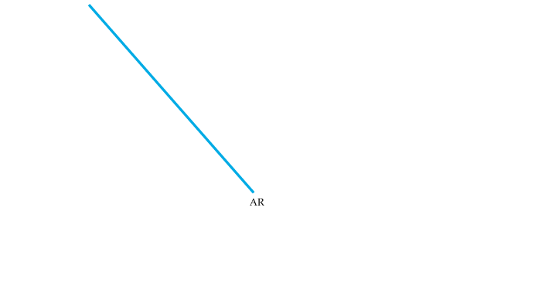


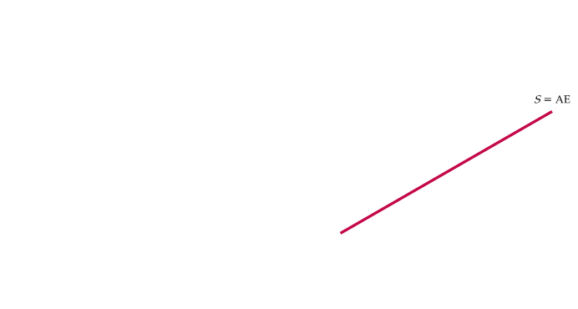

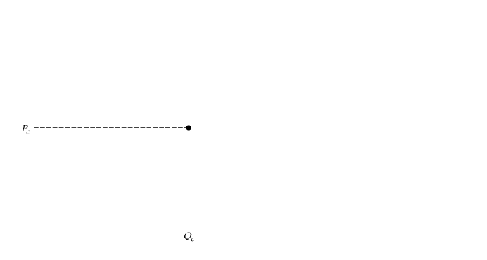
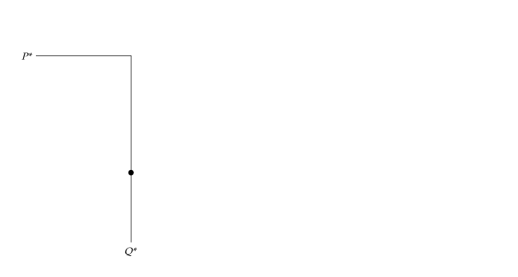
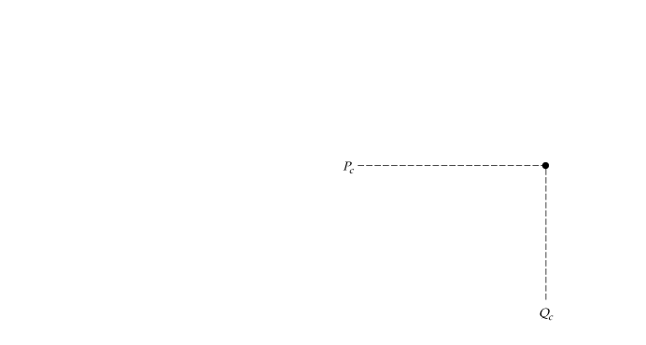
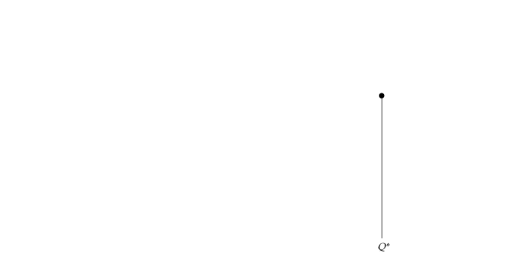

MONOPSONY
10.5
Monopsony and Monopoly Compared
Figure 10.15
Monopoly and Monopsony
These diagrams show the close analogy between monopoly and monopsony.
(a) The monopolist produces where marginal revenue intersects marginal cost.
Average revenue exceeds marginal revenue, so that price exceeds marginal cost.
(b) The monopsonist purchases up to the point where marginal expenditure intersects marginal value.
Marginal expenditure exceeds average expenditure, so that marginal value exceeds price.

